Slide 1

Onbotech: A Multi-Year Map of Technology Training/Professional Development
Framework that can be tailored to meet the needs of schools when providing technology training & PD during the onboarding and re-onboarding of faculty and staff.
Upside Down Octopi

Slide 2
An Introduction to Onbotech*
Onbotech stems from the need to move beyond onboarding as a "one and done" model that is limited to the first year of employment for faculty and staff, but rather creates a dynamic and ongoing sequence of professional development and technology training that supports all employees as they advance on their own journey of technological growth.
* Onbotech name generated by ChatGPT combining onboarding and technology

Slide 3
How to Use This Guide
Why LMS Examples?
Decide on a course sequence for your school. The course map is a suggested progression for faculty and staff.
Begin creating courses in your school’s LMS. Start out with 100 and 200 level courses. Use the details on each course page as a template and customize to your campus community needs.
Enroll newly hired employees in Tech 101 and begin existing faculty and staff at the Tech 200 level.
Professional development is teaching and learning for an adult audience.
Your school already utilizes and pays for an LMS.
Having teachers enrolled in a course as students provides valuable first-hand experience.
Modern LMS’s provide a platform for self-paced, asynchronous learning and allow users to revisit topics as needed.
You can showcase the features of your LMS to help improve teacher usage.

Slide 4
Table of Contents
Tech 303 - New and Emerging Trends In Business Technology
For all non-faculty who work with student data. Pre- or corequisite Tech 203.
Tech 401 - Independent Study for Advanced Tech Users
For all faculty and staff. Prerequisite 300 level Tech course.
Course Map
Tech 101 - Introduction to School Technology Systems
All users. No prerequisites.
Tech 201 - Making the Most of Your LMS
For faculty. Prerequisite Tech 101.
Tech 202 - Making the Most of Classroom Technology
For faculty. Prerequisite Tech 101. Pre- or corequisite Tech 201.
Tech 203 - Technology Best Practices for Staff and Administrators
For all non-faculty who work with student data. Prerequisite Tech 101.
Tech 301 - New and Emerging Trends In Educational Technology
For faculty. Prerequisite Tech 101. Pre- or corequisite Tech 201 & Tech 202.
Tech 302 - Using Technology to Differentiate Learning
For faculty. Prerequisite Tech 101. Pre- or corequisite Tech 201 & Tech 202.
Video overview of Onbotech

Slide 5
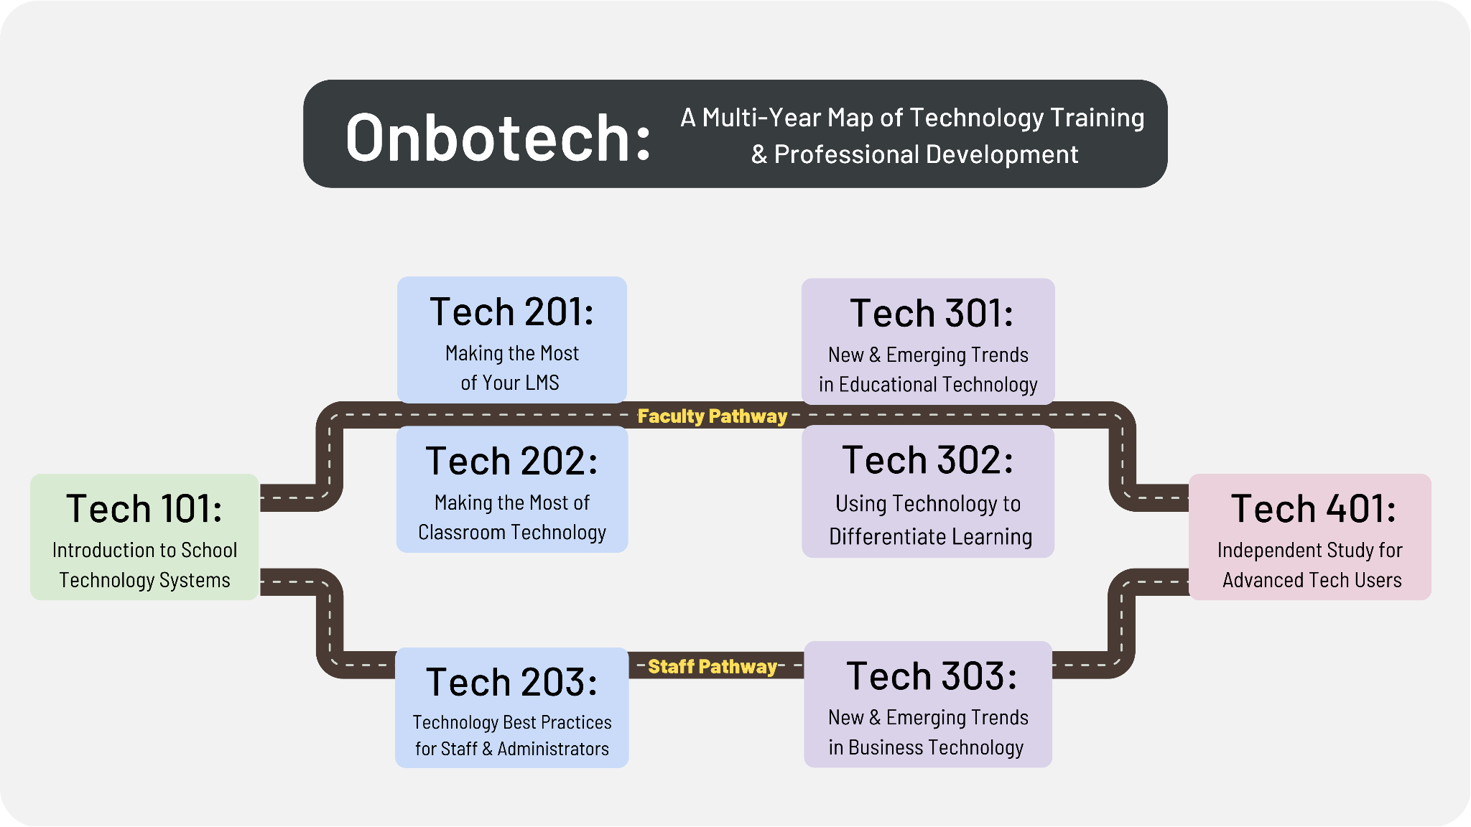

Slide 6
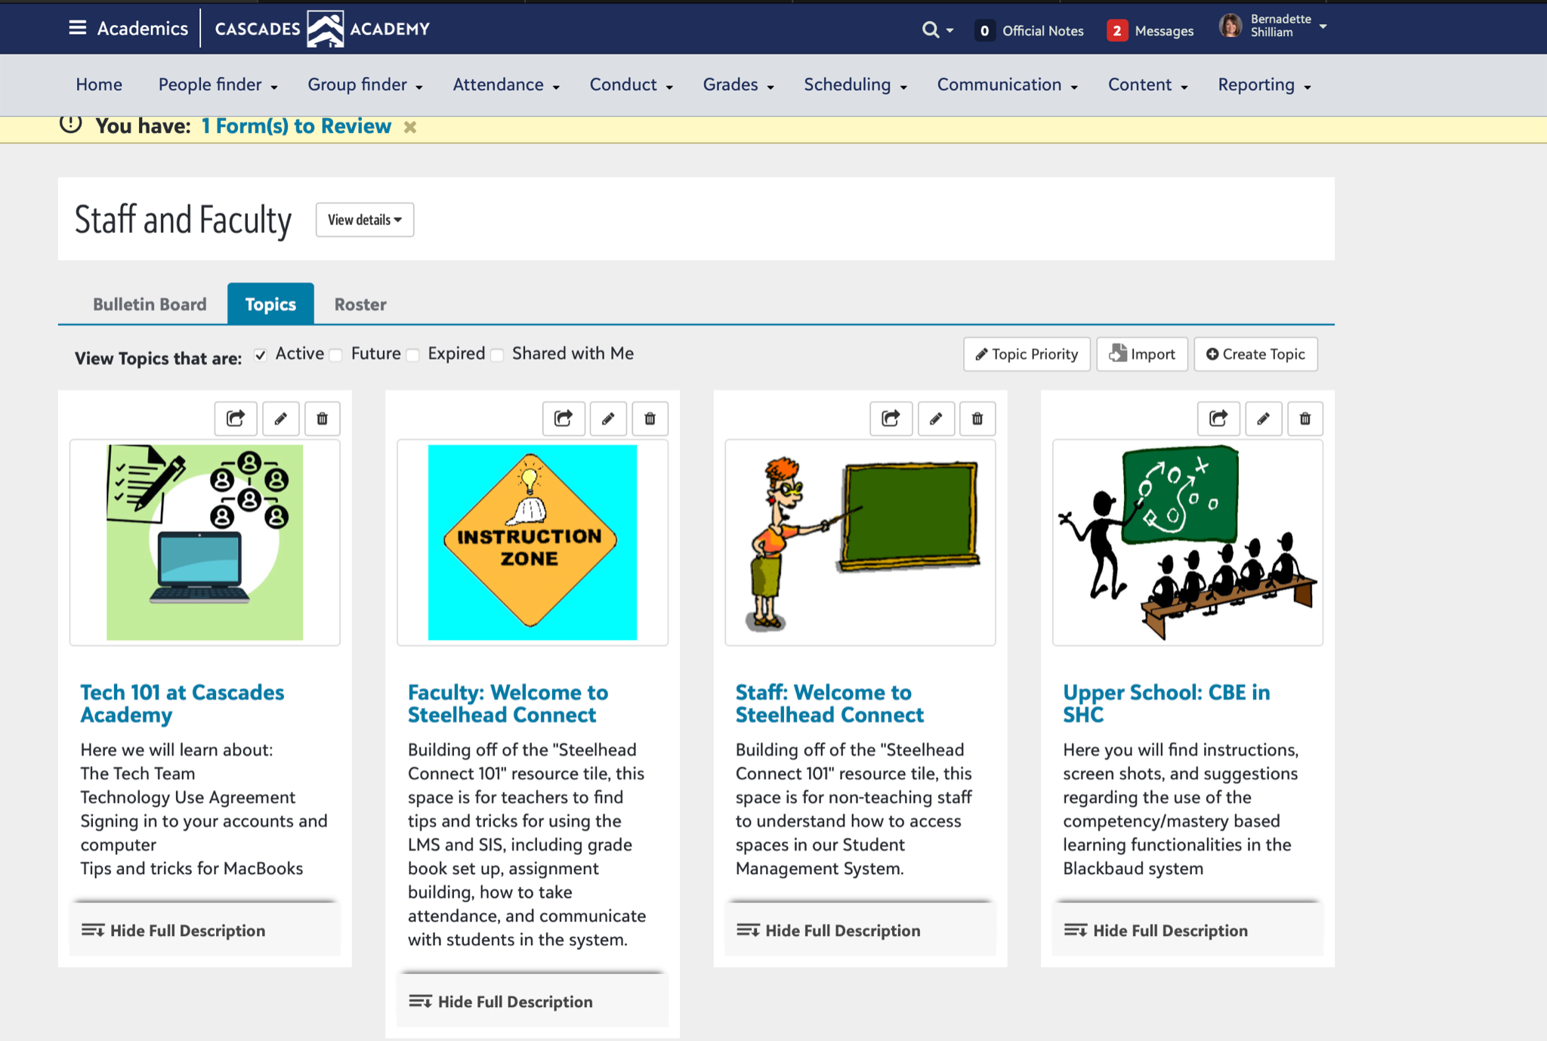
Tech 101:
Introduction to School Technology Systems
For Faculty and Staff - no prerequisite
This course is designed as a broad overview of tech at your school. Most often this information is all new staff and faculty receive, and existing faculty seldom review during their time at your school.
Meet the Tech Team
Policy Review
Sign-ins and passwords
Cyber Security
Computer use: How to’s and tips/tricks
Overview of available hardware and software
Sample Course Outline
Tools used: Blackbaud “community groups” topic page and resource tiles. Can also create a “sandbox” class where faculty can create assignments/assessments as indicated in your modules. Blackbaud schools with small faculty may also consider issuing a secondary email address to faculty to comply with their BBID requirements that would enable the option to enroll the teacher as a student and run Onbotech modules there. A staff/faculty school level should be created if a school opts for this model so as to not impact enrollment reporting.

Slide 7
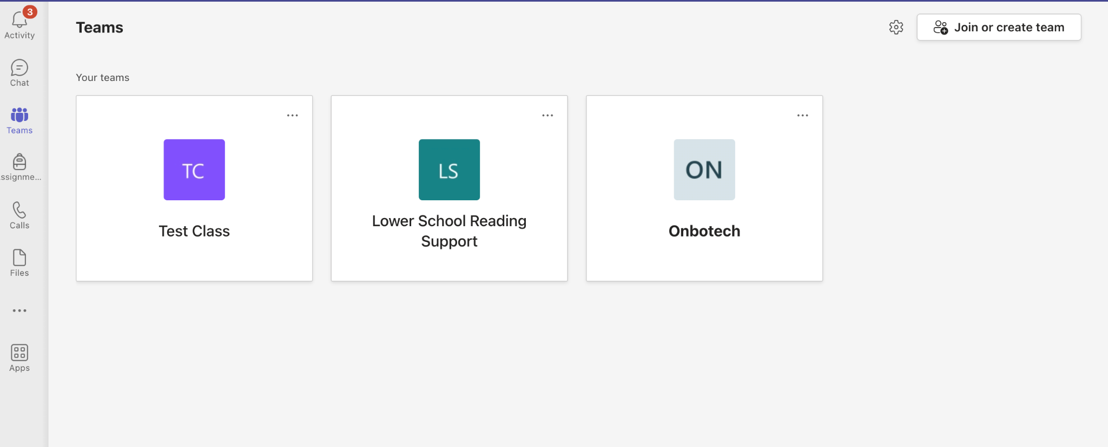
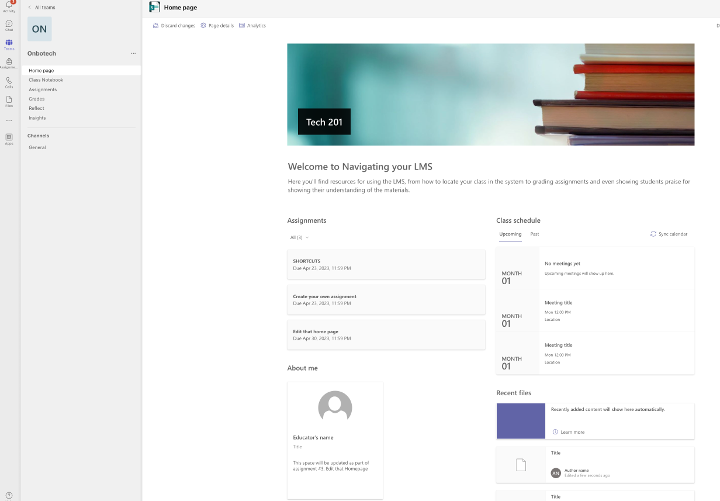
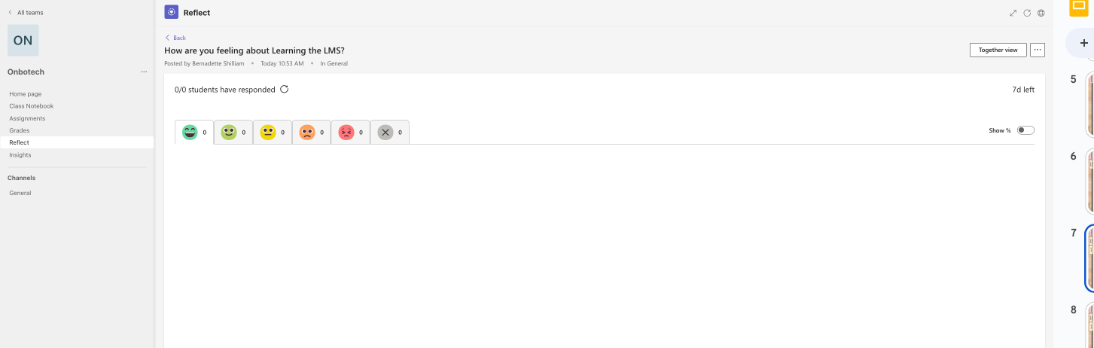
Tech 301:
Tech 201:
Making the Most of Your LMS
For Faculty Prerequisite: Tech 101
This course is to give your faculty a nuts and bolts look at the functionality of the school’s LMS. Additionally, as the designer of the modules, you can utilize tools in your LMS that may not be well known to your existing faculty and highlight shortcuts or new features.
Basic Navigation
Gradebook Settings
Assignment Creation
Grading of Assignments
Sample Course Outline
Teams features used - assignments, class notebook, reflect

Slide 8
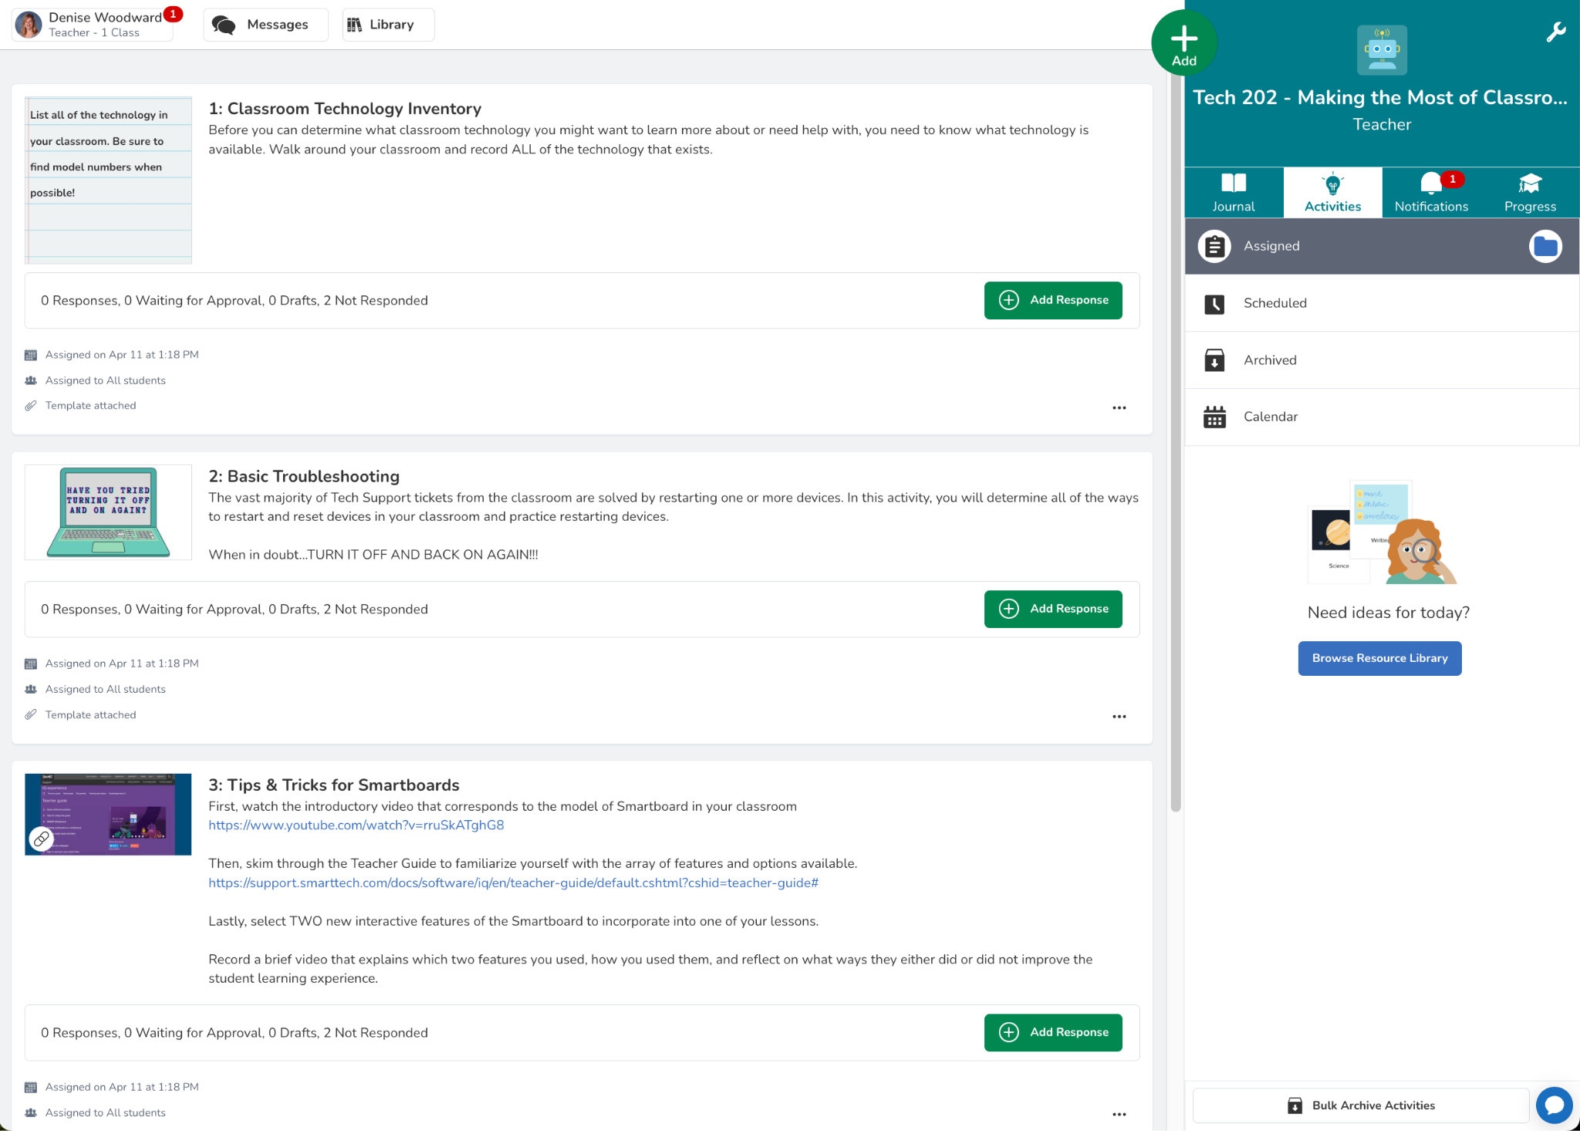
Tech 202:
Making the Most of Classroom Technology
For faculty. Prerequisite Tech 101. Pre- or corequisite Tech 201
This course is designed to introduce first and second year teachers to the full range of features available via their existing classroom technology. This course could also be assigned to veteran faculty whenever there have been significant changes or upgrades to classroom technology.
Potential course topics include:
Classroom inventory
Basic troubleshooting of classroom devices
Tips and tricks for smartboards/projectors
Using document cameras to put your best face forward (not face the board)
Using screen mirroring to move away from the front of the classroom
Classroom printing vs. photocopying
Sample Course Outline
Seesaw features used: Assignments, Student templates, Video responses, Journal, Commenting

Slide 9
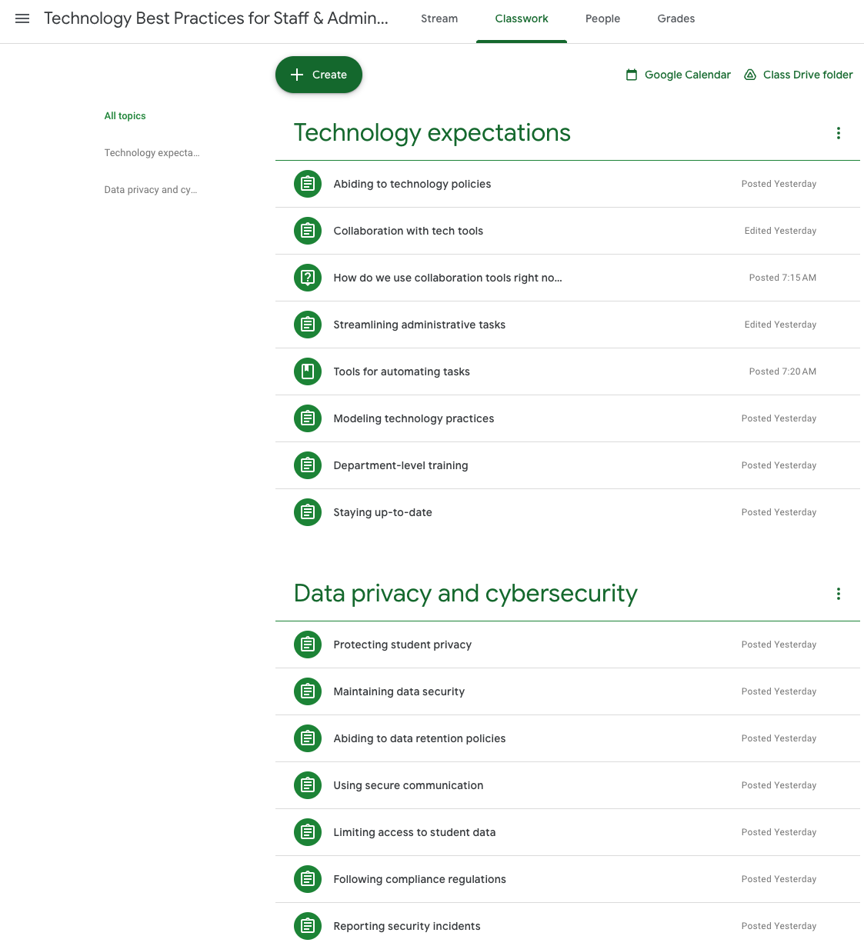
Tech 203:
Technology Best Practices for Staff & Administrators
For staff and administrators. Prerequisite Tech 101
This course provides an in-depth look at your school’s policies and procedures related to technology usage, data privacy, and cybersecurity for all employees who work with sensitive student information.
Technology expectations
Abiding to technology policies
Collaboration with tech tools
Streamlining administrative tasks
Modeling technology practices
Data privacy and cybersecurity
Protecting student privacy
Maintain data security
Follow data retention policies
Use secure communication methods
Follow compliance regulations
Report security incidents promptly
Sample Course Outline
Google Classroom features used: Assignments, Quizzes, Google Forms survey, Question prompts

Slide 10
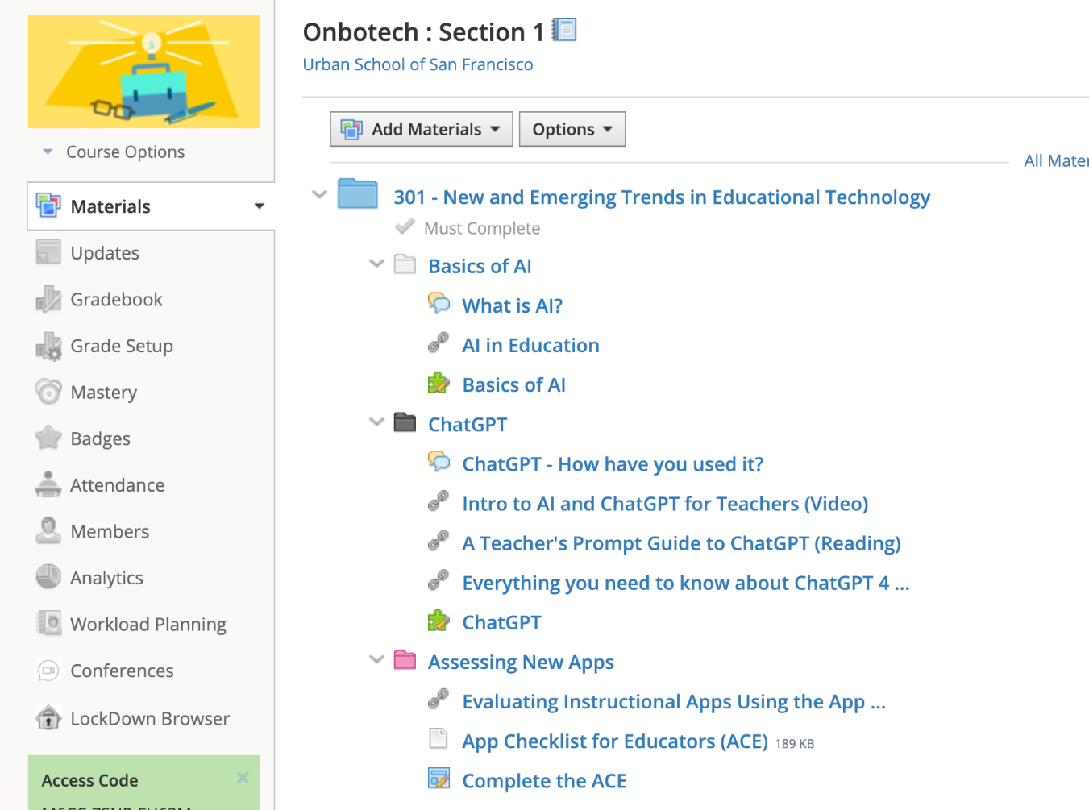

Tech 301:
New & Emerging Trends in EdTech
For faculty. Prerequisite Tech 101 / Pre or Corequisite Tech 201 & 202
This course is designed for faculty after year one who have completed Tech 101 and Tech 201/202 and covers emerging trends in EdTech. Furthermore, teachers are provided with a tool to evaluate new and emerging applications that are currently or could be utilized in the classroom.
Potential Course Topics Include:
Artificial Intelligence in Education
Chat GPT
Adaptive Assessment Tools
Updates to LMS
Assessing New and Emerging Applications
Sample Course Outline
Schoology features used: Student Completion Rules, Discussion Boards, Assignments, Quizzes as Exit Slips, Badge of Completion

Slide 11
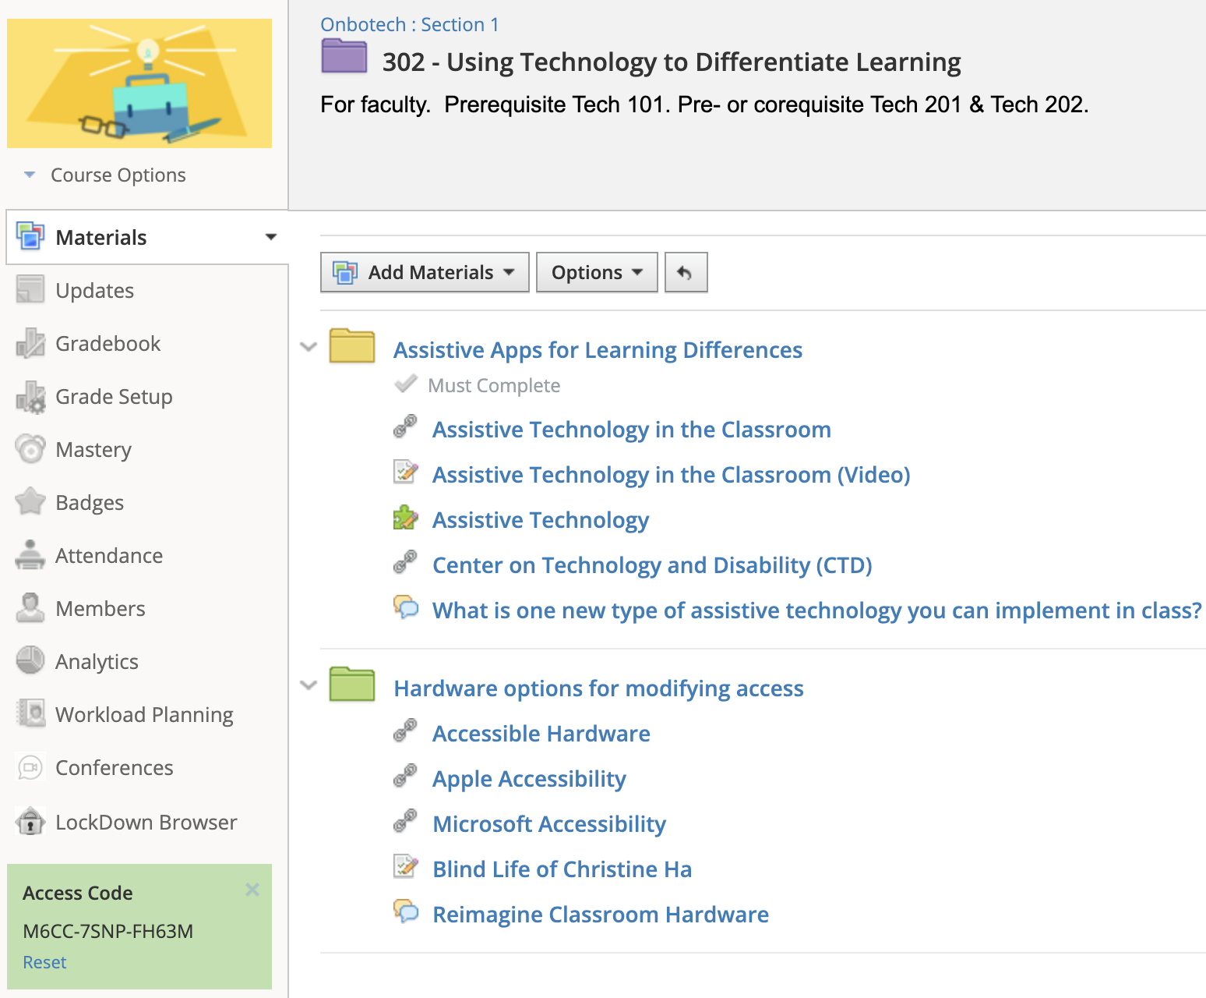
Tech 302:
Using Technology to Differentiate Learning
For faculty. Prerequisite Tech 101 / Pre or Corequisite Tech 201 & 202
This course is designed for faculty after year one who have completed Tech 101 and Tech 201/202 and covers emerging trends in EdTech. Furthermore, teachers are provided with a tool to evaluate new and emerging applications that are currently or could be utilized in the classroom.
Potential Course Topics Include:
Assistive Applications
Setting up Assistive Support on both Mac and Windows Operating Systems
Reimagining the DEIB Classroom
Hardware for Modifying Access
AT & ILPs
Sample Course Outline
Schoology features used: Student Completion Rules, Quiz questions in audio and text format, Discussion Boards, Embedded Videos, Badge of Completion

Slide 12
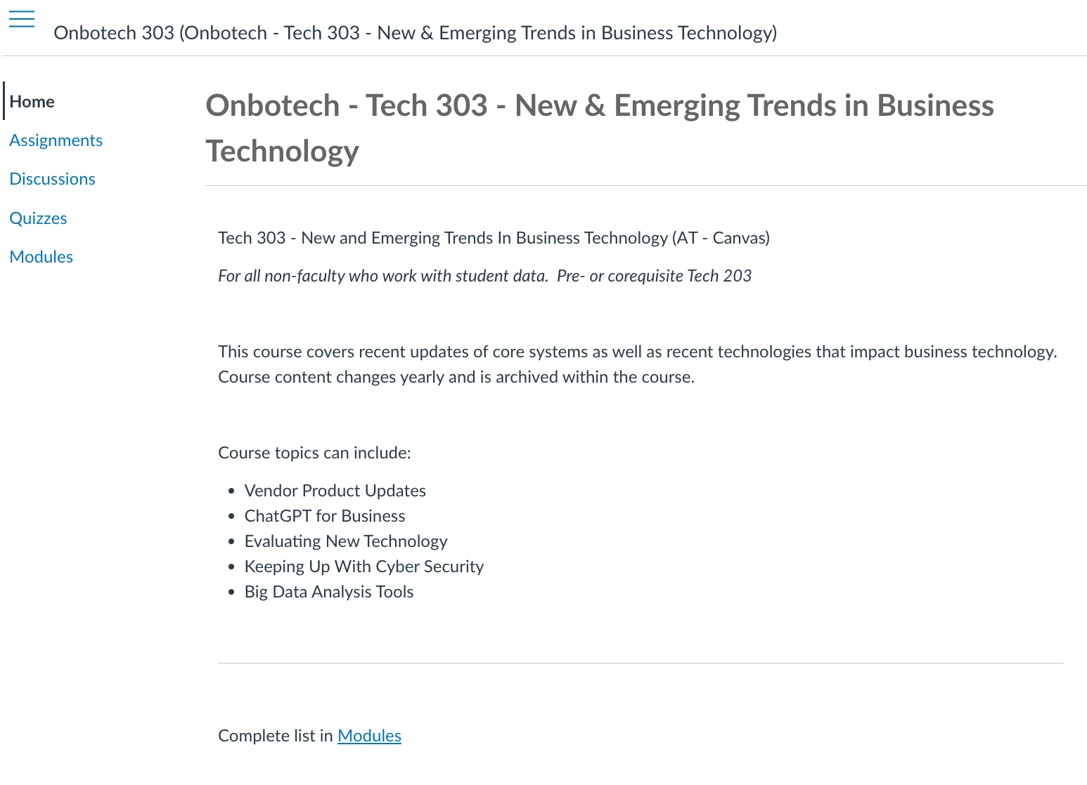
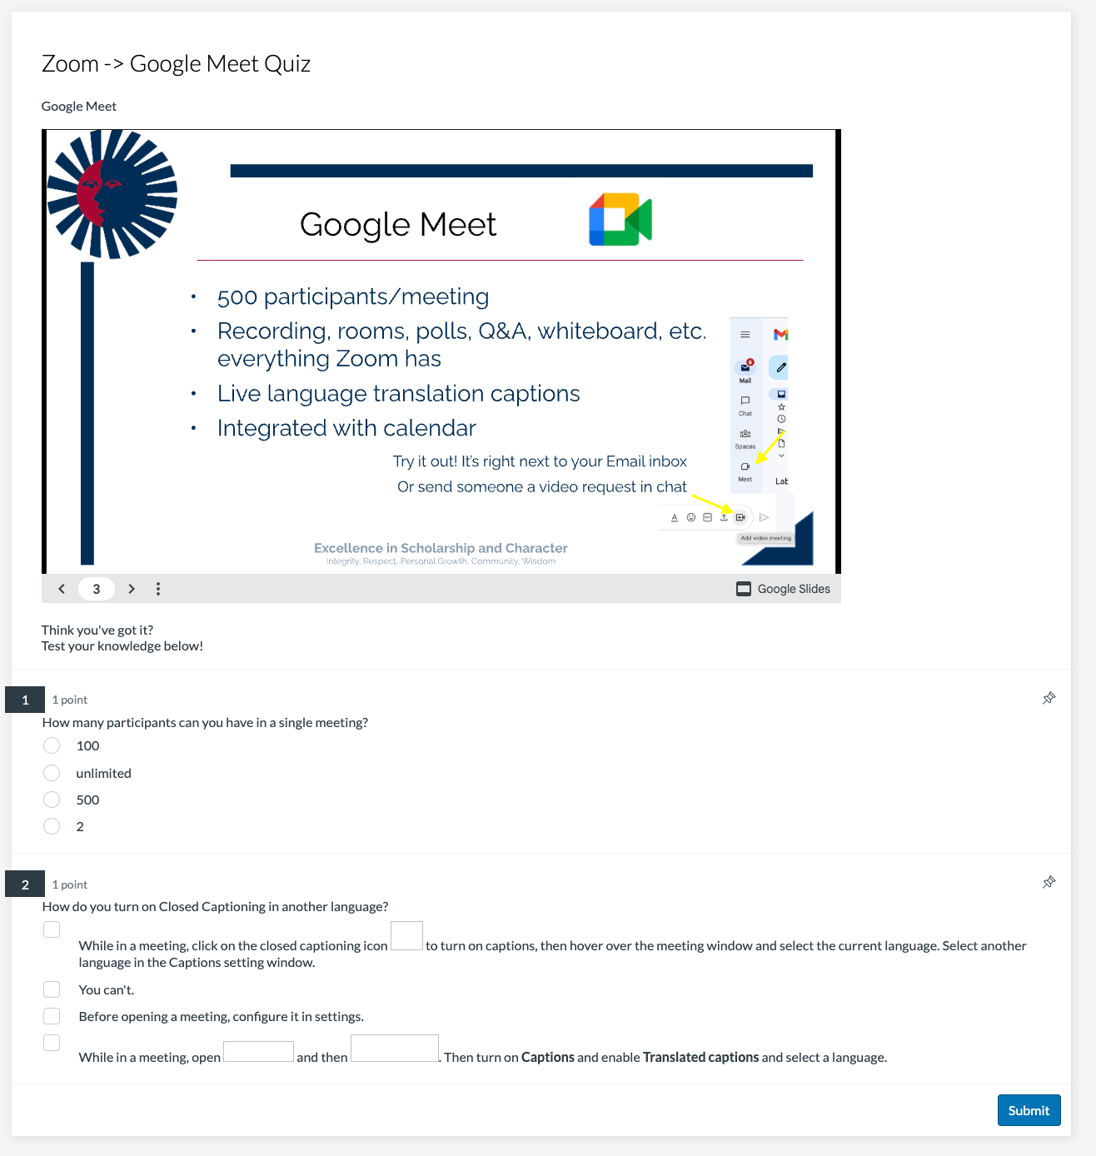
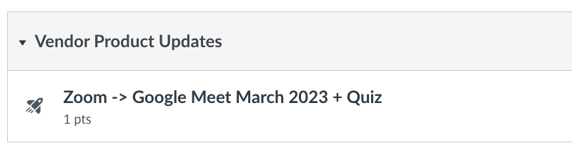
Tech 303:
New & Emerging Trends in Business Technology
For all non-faculty who work with student data. Pre- or corequisite Tech 203
This course covers recent updates of core systems as well as recent technologies that impact business technology. Course content changes yearly and is archived within the course.
Course topics can include:
Vendor Product Updates
ChatGPT for Business
Evaluating New Technology
Keeping Up With Cyber Security
Big Data Analysis Tools
Canvas features used: Pages, Quizzes, Embedded Content
Notes:
Course document outline still in progress 4/23/2023
https://docs.google.com/document/d/1yFXiS4Atgmagpkh2hejjdEX67vfcZyzbLUI5BtuTqW8/edit

Slide 13
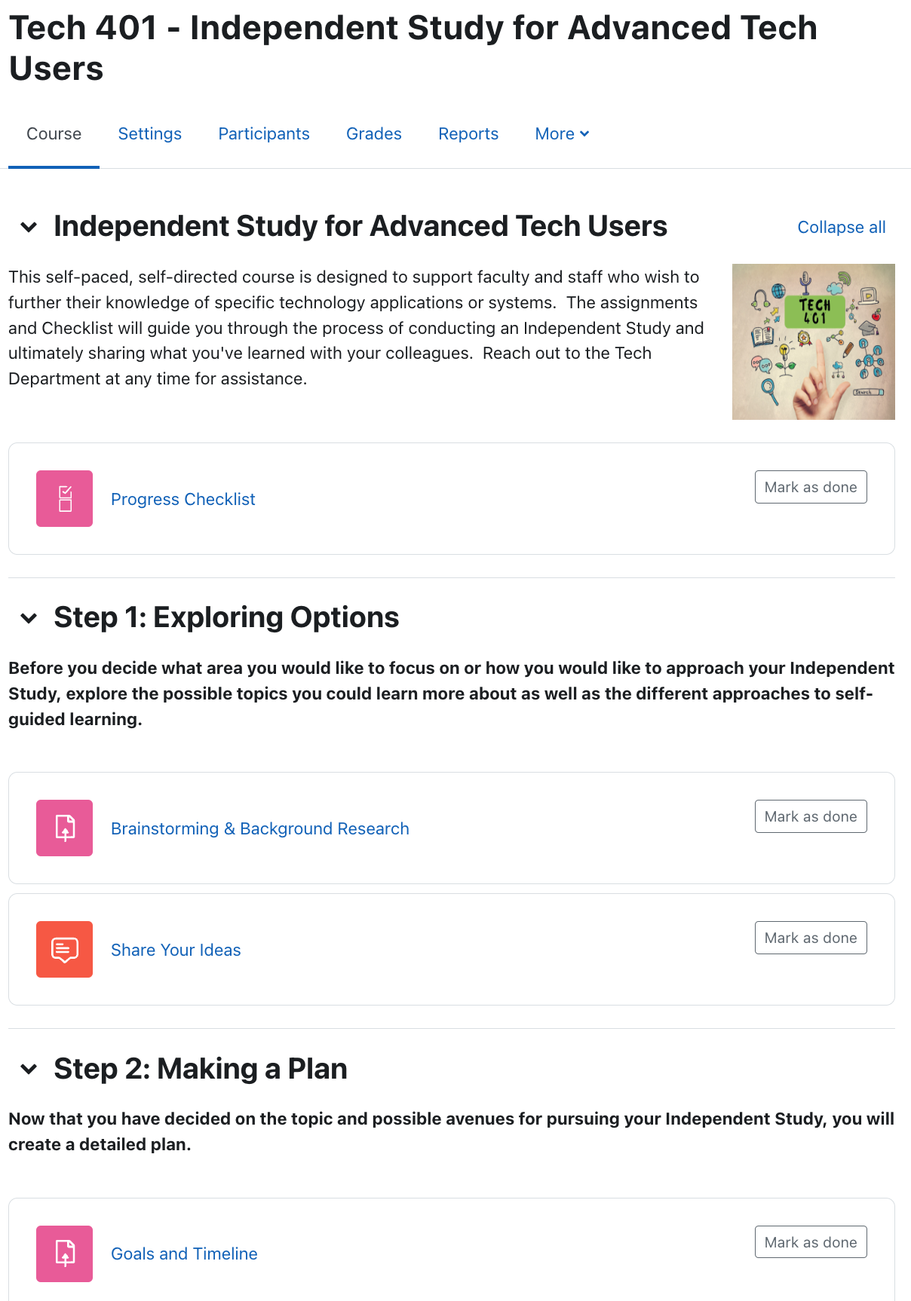
Tech 401:
Independent Study for Advanced Tech Users
For all faculty and staff. Prerequisite 300 level Tech course
This self-paced, self-directed course is designed for veteran faculty and staff who have demonstrated high levels of proficiency and usage of existing technology on campus. This course provides them with an opportunity to pursue a topic of interest in greater depth with support from the Technology department.
Individual directed professional development
May be through an outside source/vendor
May lead to teaching a portion of a 300 level course
May provide a path for professional advancement for faculty
May be used to meet annual professional development goals for faculty or staff
Sample Course Outline
Moodle features used: Assignments, Checklist, Forum, Quiz, Custom Certificate

Slide 14
Thank you!
A BIG thank you to Peter Antupit for guiding our team:
Alex Demushkane
Bernadette Shilliam
Andrew Teets
Denise Woodward
Camelia Perez
Upside Down Octopi

